Slide 1
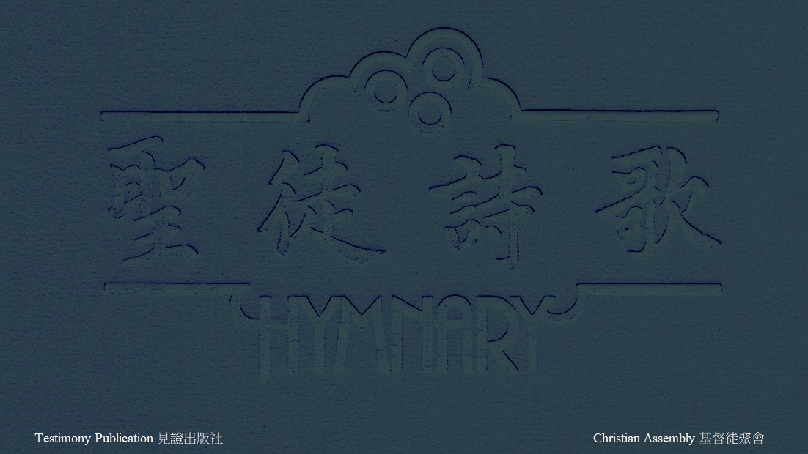
H006 主阿，祢的名何其美 HOW EXCELLENT IS THY NAME (1/1)
主阿，祢的名在全地何其美！(2X)
How Excellent, O Lord, is Thy Name in all the earth! (2X)
祢將祢榮耀彰顯於天：
Who hast set Thy glory above the heavens:
祢指頭造的天，並月亮、星宿。
The works of Thy fingers, the moon and the stars.
主阿，祢的名在全地何其美！
How Excellent, O Lord, is Thy name in all the earth!

